Slide 1
计算机视觉 第09章 CNN图像分类
软件学院: 刘春
Ref: EECS 498-007, Deep Learning for Computer Vision
Prof. Justin Johnson

Slide 2
本章内容
9.1.ImageNet分类挑战
9.2.AlexNet
9.3.VGG
9.4.GoogleNet
9.5.Residual Network
9.6.不同网络比较及改进

Slide 3
ImageNet分类挑战
Lin et al
Sanchez & Perronnin
Krizhevsky et al (AlexNet)
Zeiler & Fergus
Simonyan & Zisserman (VGG)
Szegedy et al (GoogLeNet)
He et al (ResNet)
Shao et al
Hu et al
(SENet)
Russakovsky et al

Slide 4
ImageNet分类挑战
Lin et al
Sanchez & Perronnin
Krizhevsky et al (AlexNet)
Zeiler & Fergus
Simonyan & Zisserman (VGG)
Szegedy et al (GoogLeNet)
He et al (ResNet)
Shao et al
Hu et al
(SENet)
Russakovsky et al

Slide 5
本章内容
9.1.ImageNet分类挑战
9.2.AlexNet
9.3.VGG
9.4.GoogleNet
9.5.Residual Network
9.6.不同网络比较及改进

Slide 6
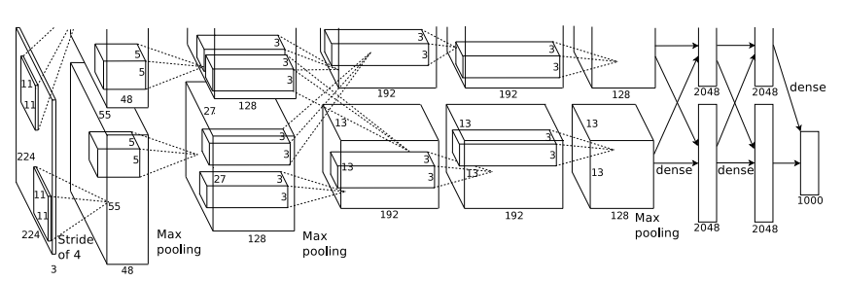
9.1 AlexNet
227 x 227 输入
5 卷积层
最大池化
3 全连接层
ReLU 激活
Figure copyright Alex Krizhevsky, Ilya Sutskever, and Geoffrey Hinton, 2012. Reproduced with permission.

Slide 7
AlexNet
使用 “局部响应归一化”;
目前已经不使用
使用两块GTX 580 GPUs 训练– 仅仅3GB 存储空间! 模型分割到两块GPUs
227 x 227 输入
5 卷积层
最大池化
3 全连接层
ReLU 激活
Figure copyright Alex Krizhevsky, Ilya Sutskever, and Geoffrey Hinton, 2012. Reproduced with permission.

Slide 8
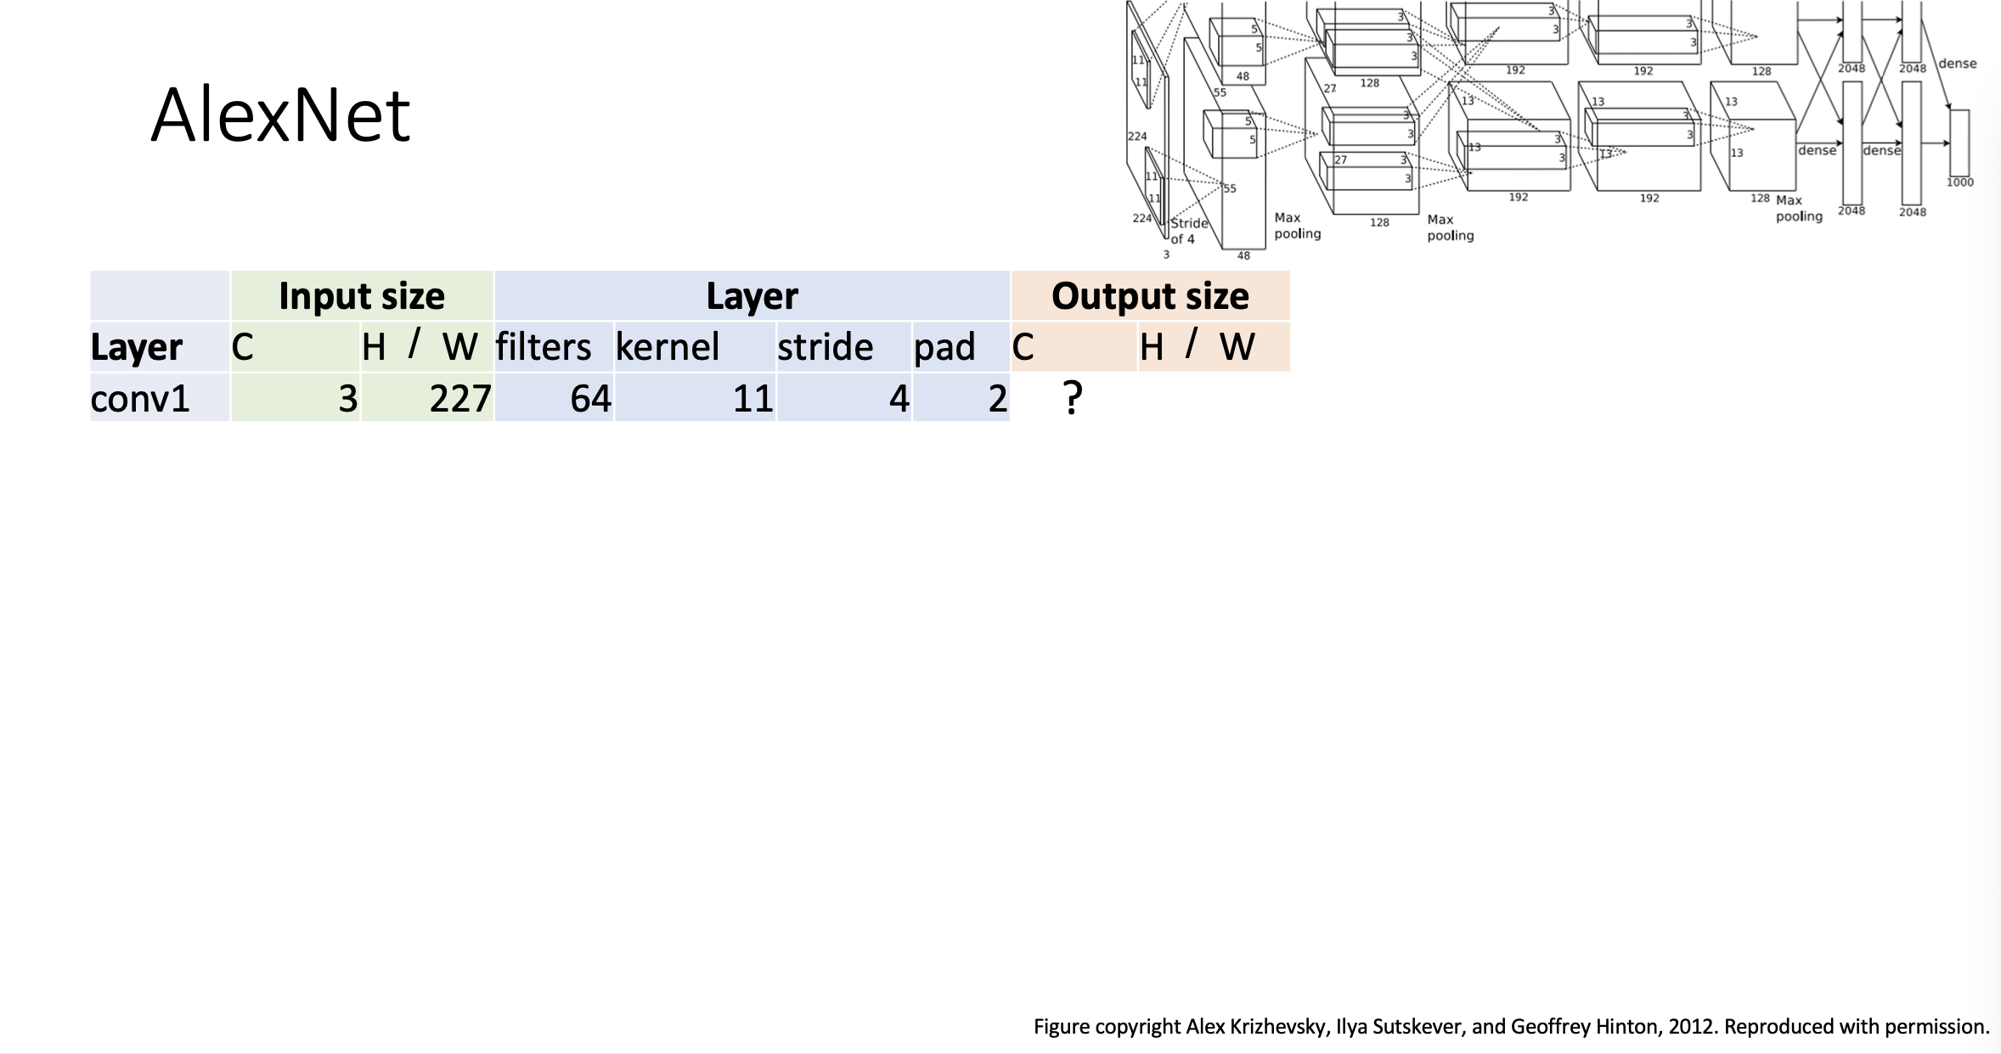

Slide 9
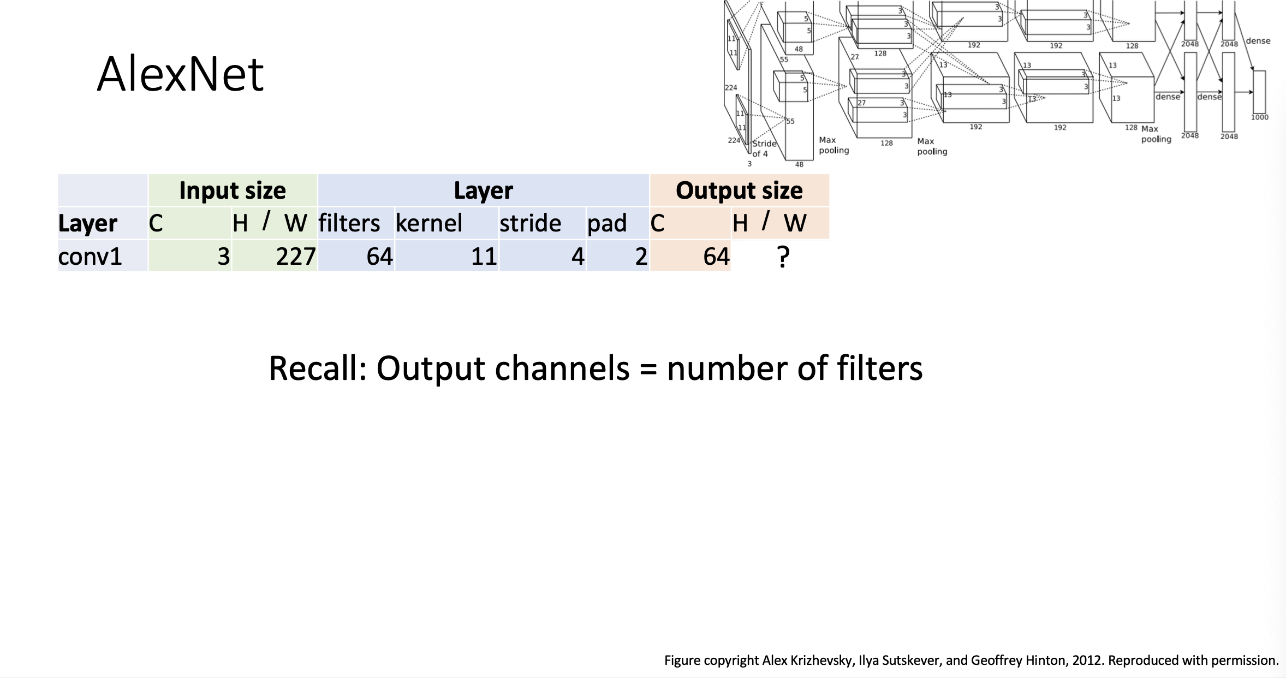

Slide 10
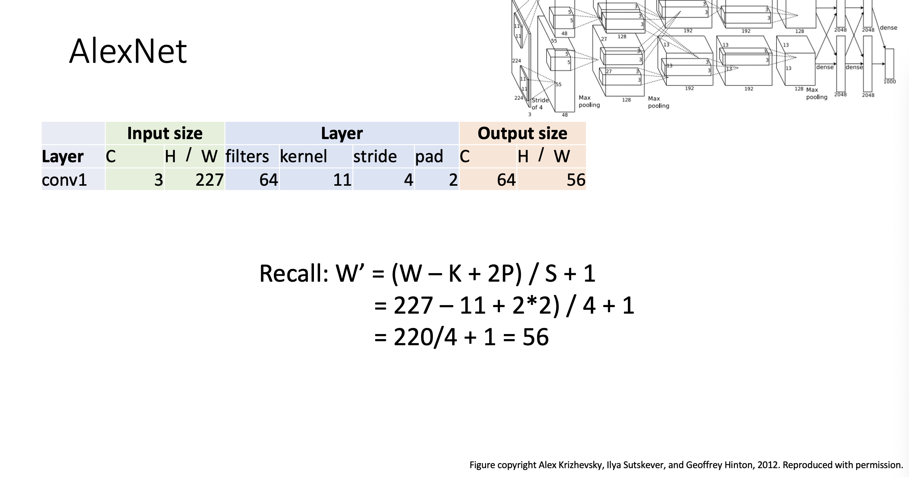

Slide 11
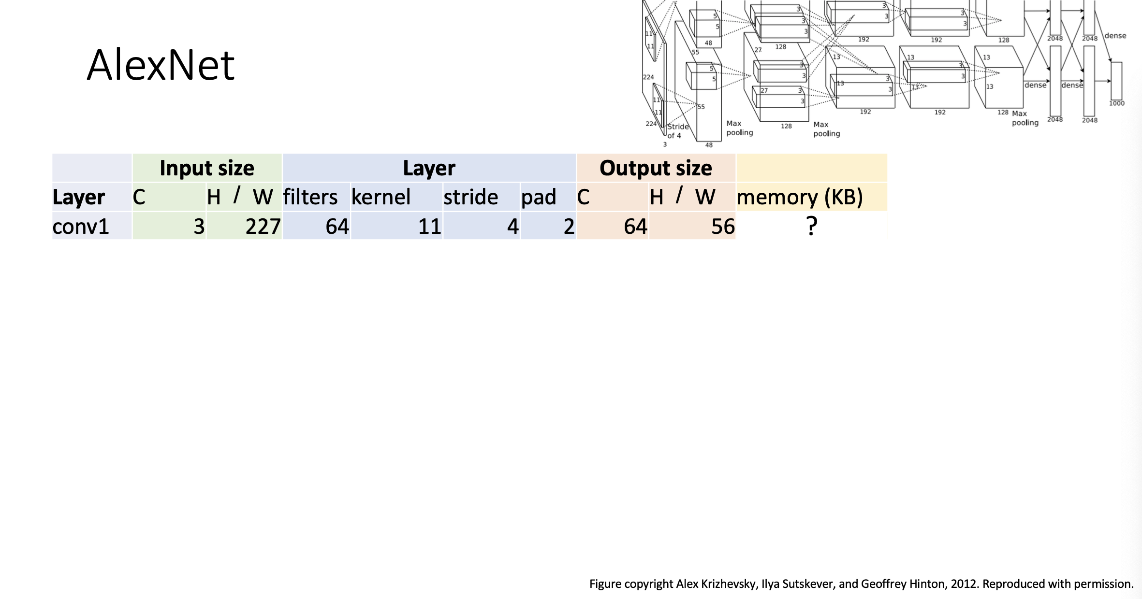

Slide 12
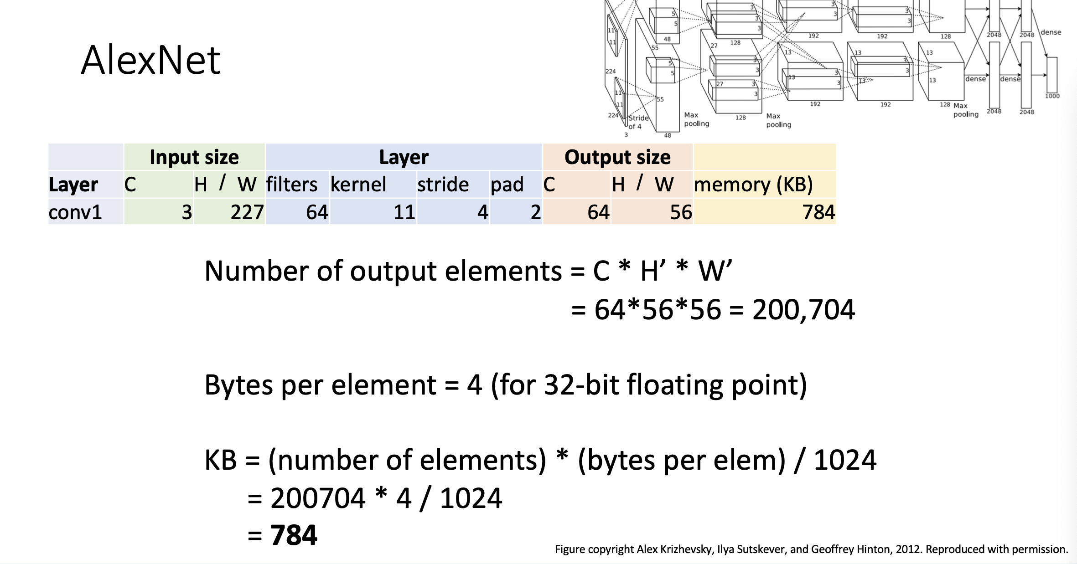

Slide 13
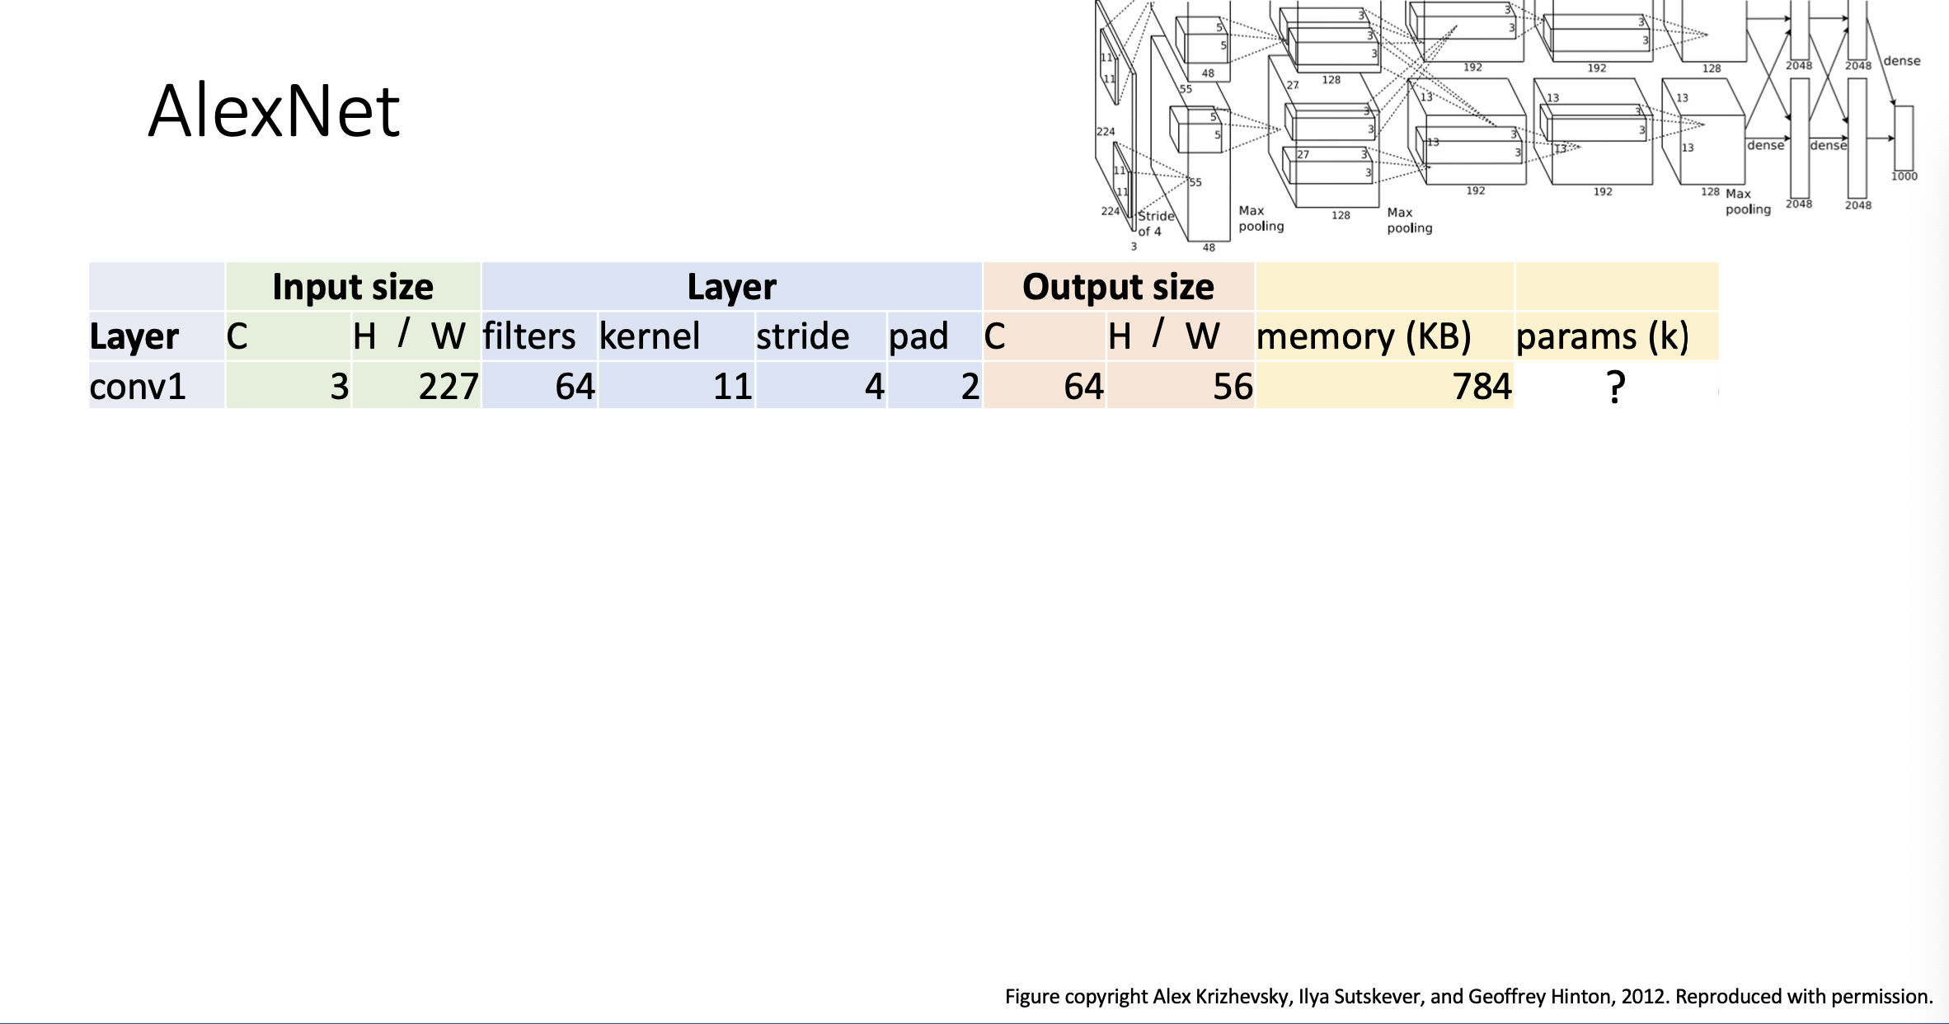

Slide 14
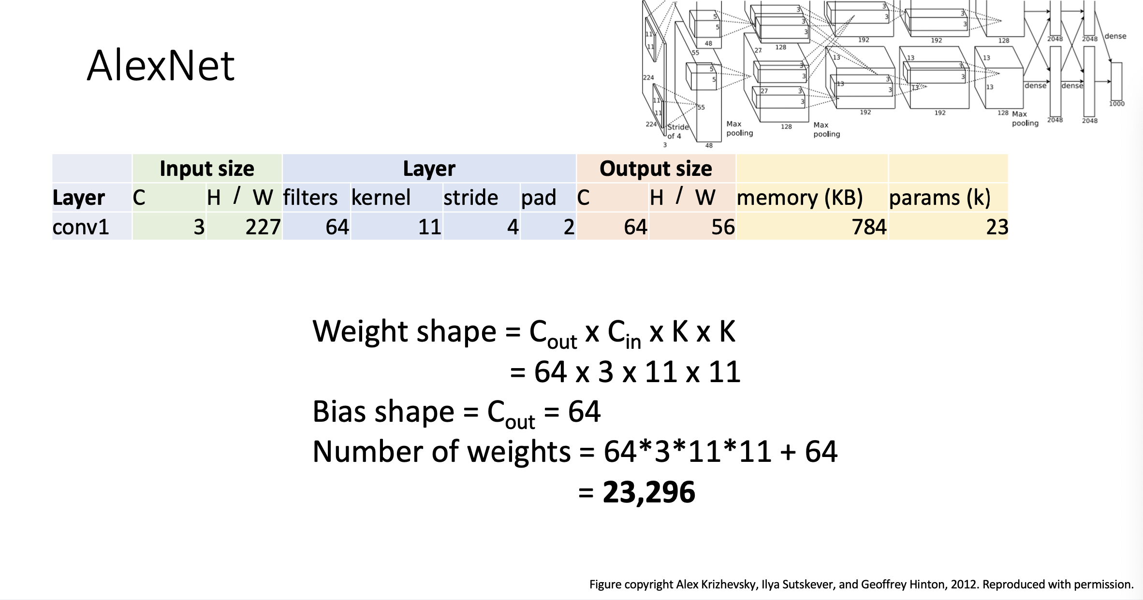

Slide 15
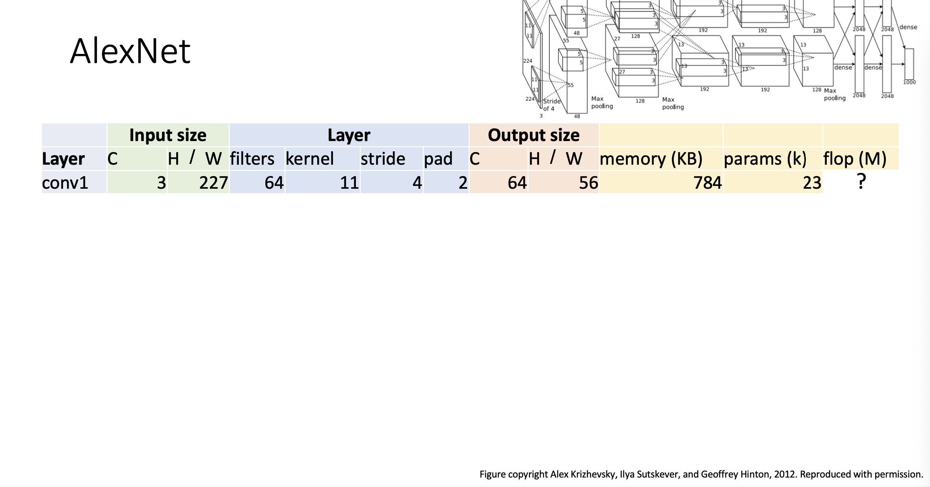

Slide 16
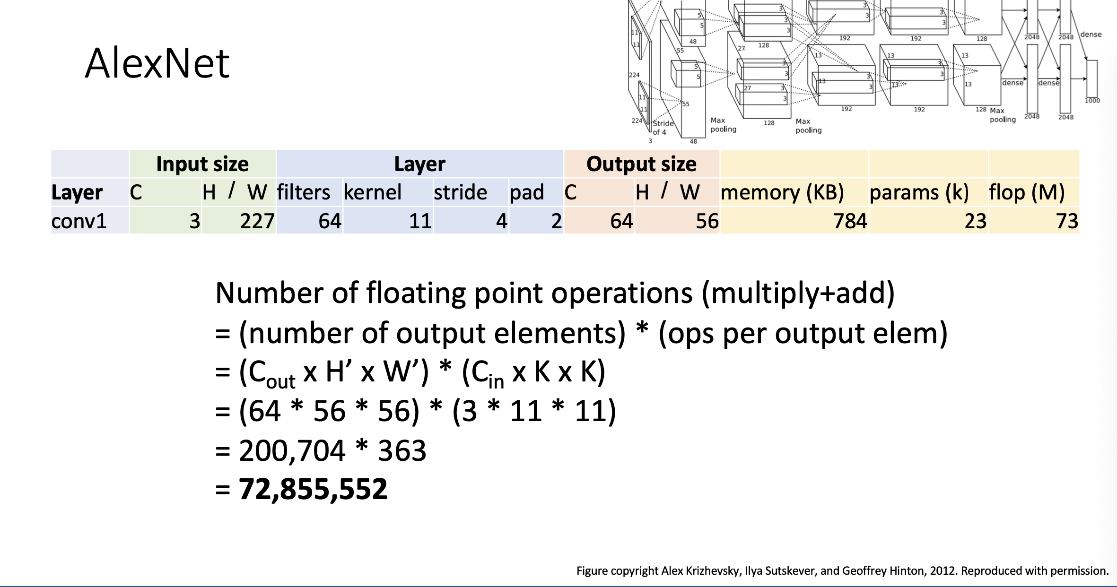

Slide 17
AlexNet
注意变化趋势!
 | Input size |  | Layer |  |  |  | Output size
Layer | C | H / W | filters | kernel | stride | pad | C | H / W | memory (KB) | params (k) | flop (M)
conv1 | 3 | 227 | 64 | 11 | 4 | 2 | 64 | 56 | 784 | 23 | 73
pool1 | 64 | 56 |  | 3 | 2 | 0 | 64 | 27 | 182 | 0 | 0
conv2 | 64 | 27 | 192 | 5 | 1 | 2 | 192 | 27 | 547 | 307 | 224
pool2 | 192 | 27 |  | 3 | 2 | 0 | 192 | 13 | 127 | 0 | 0
conv3 | 192 | 13 | 384 | 3 | 1 | 1 | 384 | 13 | 254 | 664 | 112
conv4 | 384 | 13 | 256 | 3 | 1 | 1 | 256 | 13 | 169 | 885 | 145
conv5 | 256 | 13 | 256 | 3 | 1 | 1 | 256 | 13 | 169 | 590 | 100
pool5 | 256 | 13 |  | 3 | 2 | 0 | 256 | 6 | 36 | 0 | 0
flatten | 256 | 6 |  |  |  |  | 9216 |  | 36 | 0 | 0
fc6 | 9216 |  | 4096 |  |  |  | 4096 |  | 16 | 37,749 | 38
fc7 | 4096 |  | 4096 |  |  |  | 4096 |  | 16 | 16,777 | 17
fc8 | 4096 |  | 1000 |  |  |  | 1000 |  | 4 | 4,096 | 4

Slide 18
AlexNet
存储主要在卷积层
参数主要在全连接层
运算主要在卷积层

Slide 19
ImageNet分类挑战
Lin et al
Sanchez & Perronnin
Krizhevsky et al (AlexNet)
Zeiler & Fergus
Simonyan & Zisserman (VGG)
Szegedy et al (GoogLeNet)
He et al (ResNet)
Shao et al
Hu et al
(SENet)
Russakovsky et al

Slide 20
ImageNet分类挑战
Lin et al
Sanchez & Perronnin
Krizhevsky et al (AlexNet)
Zeiler & Fergus
Simonyan & Zisserman (VGG)
Szegedy et al (GoogLeNet)
He et al (ResNet)
Shao et al
Hu et al
(SENet)
Russakovsky et al

Slide 21
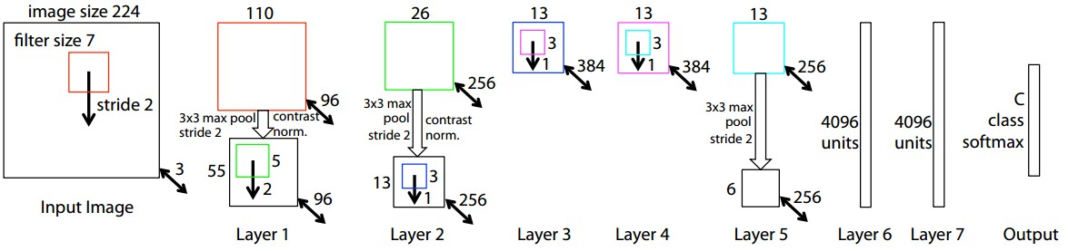
ZFNet: 一个大型AlexNet
ImageNet top 5 错误: 16.4% -> 11.7%
AlexNet 但:
CONV1: 从 (11x11 stride 4) 修改为 (7x7 stride 2)
CONV3,4,5: 使用512, 1024, 512替换384, 384, 256滤波核
Zeiler and Fergus, “Visualizing and Understanding Convolutional Networks”, ECCV 2014

Slide 22
本章内容
9.1.ImageNet分类挑战
9.2.AlexNet
9.3.VGG
9.4.GoogleNet
9.5.Residual Network
9.6.不同网络比较及改进

Slide 23
ImageNet分类挑战
Lin et al
Sanchez & Perronnin
Krizhevsky et al (AlexNet)
Zeiler & Fergus
Simonyan & Zisserman (VGG)
Szegedy et al (GoogLeNet)
He et al (ResNet)
Shao et al
Hu et al
(SENet)
Russakovsky et al

Slide 24
ImageNet分类挑战
Lin et al
Sanchez & Perronnin
Krizhevsky et al (AlexNet)
Zeiler & Fergus
Simonyan & Zisserman (VGG)
Szegedy et al (GoogLeNet)
He et al (ResNet)
Shao et al
Hu et al
(SENet)
Russakovsky et al

Slide 25
VGG: 更深的网络
Softmax
FC 1000
Softmax
FC 4096
VGG 设计规则:
所有conv 使用 3x3 stride 1 pad 1
所有 max 池化使用 2x2 stride 2
池化后, 双倍输出通道
FC 1000
FC 4096
FC 4096
Pool
FC 4096
3x3 conv, 512
Pool
3x3 conv, 512
3x3 conv, 512
3x3 conv, 512
3x3 conv, 512
3x3 conv, 512
3x3 conv, 512
Pool
Pool
3x3 conv, 512
Softmax
3x3 conv, 512
3x3 conv, 512
网络包含5个卷积段:
阶段 1: conv-conv-pool
阶段 2: conv-conv-pool
阶段 3: conv-conv-pool
阶段 4: conv-conv-conv-[conv]-pool
阶段 5: conv-conv-conv-[conv]-pool
(VGG-19在阶段4和5有4conv )
FC 1000
3x3 conv, 512
3x3 conv, 512
FC 4096
3x3 conv, 512
3x3 conv, 512
FC 4096
Pool
Pool
Pool
3x3 conv, 256
3x3 conv, 256
3x3 conv, 256
3x3 conv, 256
3x3 conv, 256
3x3 conv, 384
Pool
Pool
Pool
3x3 conv, 128
3x3 conv, 128
3x3 conv, 384
3x3 conv, 128
3x3 conv, 128
Pool
Pool
Pool
5x5 conv, 256
3x3 conv, 64
3x3 conv, 64
11x11 conv, 96
3x3 conv, 64
3x3 conv, 64
Input
Input
Input
AlexNet
VGG16
VGG19
Simonyan and Zissermann, “Very Deep Convolutional Networks for Large-Scale Image Recognition”, ICLR 2015

Slide 26
VGG:更深的网络
Softmax
FC 1000
Softmax
FC 4096
VGG 设计规则:
所有conv 使用 3x3 stride 1 pad 1
所有 max 池化使用 2x2 stride 2
池化后, 双倍输出通道
两个 3x3 conv 和 一个5x5 conv有相同的感受野, 但参数和计算都变少
FC 1000
FC 4096
FC 4096
Pool
FC 4096
3x3 conv, 512
Pool
3x3 conv, 512
3x3 conv, 512
3x3 conv, 512
3x3 conv, 512
3x3 conv, 512
3x3 conv, 512
Pool
Pool
3x3 conv, 512
Softmax
3x3 conv, 512
3x3 conv, 512
FC 1000
3x3 conv, 512
3x3 conv, 512
选项1:
Conv(5x5, C -> C)
Params: 25C²
FLOPs: 25C²HW
选项2:
Conv(3x3, C -> C)
Conv(3x3, C -> C)
Params: 18C²
FLOPs: 18C²HW
FC 4096
3x3 conv, 512
3x3 conv, 512
FC 4096
Pool
Pool
Pool
3x3 conv, 256
3x3 conv, 256
3x3 conv, 256
3x3 conv, 256
3x3 conv, 256
3x3 conv, 384
Pool
Pool
Pool
3x3 conv, 128
3x3 conv, 128
3x3 conv, 384
3x3 conv, 128
3x3 conv, 128
Pool
Pool
Pool
5x5 conv, 256
3x3 conv, 64
3x3 conv, 64
11x11 conv, 96
3x3 conv, 64
3x3 conv, 64
Input
Input
Input
AlexNet
VGG16
VGG19
Simonyan and Zissermann, “Very Deep Convolutional Networks for Large-Scale Image Recognition”, ICLR 2015

Slide 27
AlexNet vs VGG-16!
AlexNet 总共: 1.9 MB
VGG-16 总共: 48.6 MB (25x)
AlexNet 总共: 61M
VGG-16 总共: 138M (2.3x)
AlexNet 总共: 0.7 GFLOP
VGG-16 总共: 13.6 GFLOP (19.4x)

Slide 28
本章内容
9.1.ImageNet分类挑战
9.2.AlexNet
9.3.VGG
9.4.GoogleNet
9.5.Residual Network
9.6.不同网络比较及改进

Slide 29
ImageNet分类挑战
Lin et al
Sanchez & Perronnin
Krizhevsky et al (AlexNet)
Zeiler & Fergus
Simonyan & Zisserman (VGG)
Szegedy et al (GoogLeNet)
He et al (ResNet)
Shao et al
Hu et al
(SENet)
Russakovsky et al

Slide 30
ImageNet分类挑战
Lin et al
Sanchez & Perronnin
Krizhevsky et al (AlexNet)
Zeiler & Fergus
Simonyan & Zisserman (VGG)
Szegedy et al (GoogLeNet)
He et al (ResNet)
Shao et al
Hu et al
(SENet)
Russakovsky et al

Slide 31
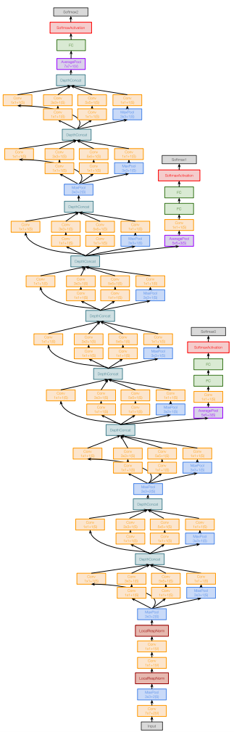
9.3 GoogLeNet: 聚焦在效率提升
主要创新点在于效率提升: 减少参数规模, 存储空间, 计算
Szegedy et al, “Going deeper with convolutions”, CVPR 2015

Slide 32
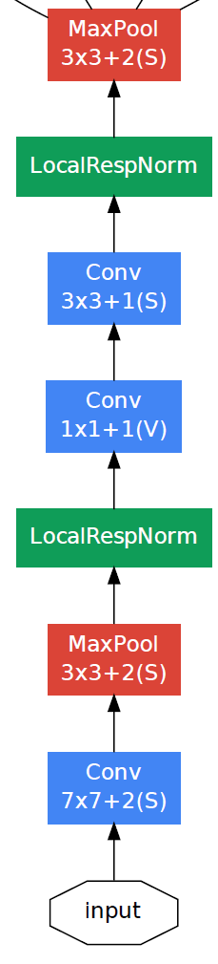
GoogLeNet: 主干
主干网络 起始位置快速下采样
(回想VGG-16: 大部分计算在起始层)
Szegedy et al, “Going deeper with convolutions”, CVPR 2015

Slide 33
GoogLeNet: 主干
主干网络 起始位置快速下采样
(回想VGG-16: 大部分计算在起始层)
 | Input size |  | Layer |  |  |  | Output size
Layer | C | H / W | filters | kernel | stride | pad | C | H/W | memory (KB) | params (K) | flop (M)
conv | 3 | 224 | 64 | 7 | 2 | 3 | 64 | 112 | 3136 | 9 | 118
max-pool | 64 | 112 |  | 3 | 2 | 1 | 64 | 56 | 784 | 0 | 2
conv | 64 | 56 | 64 | 1 | 1 | 0 | 64 | 56 | 784 | 4 | 13
conv | 64 | 56 | 192 | 3 | 1 | 1 | 192 | 56 | 2352 | 111 | 347
max-pool | 192 | 56 |  | 3 | 2 | 1 | 192 | 28 | 588 | 0 | 1
空间分辨率从224 到 28 :
Memory: 7.5 MB
Params: 124K
MFLOP: 418
Szegedy et al, “Going deeper with convolutions”, CVPR 2015

Slide 34
GoogLeNet:主干
主干网络 起始位置快速下采样
(回想VGG-16: 大部分计算在起始层)
 | Input size |  | Layer |  |  |  | Output size
Layer | C | H / W | filters | kernel | stride | pad | C | H/W | memory (KB) | params (K) | flop (M)
conv | 3 | 224 | 64 | 7 | 2 | 3 | 64 | 112 | 3136 | 9 | 118
max-pool | 64 | 112 |  | 3 | 2 | 1 | 64 | 56 | 784 | 0 | 2
conv | 64 | 56 | 64 | 1 | 1 | 0 | 64 | 56 | 784 | 4 | 13
conv | 64 | 56 | 192 | 3 | 1 | 1 | 192 | 56 | 2352 | 111 | 347
max-pool | 192 | 56 |  | 3 | 2 | 1 | 192 | 28 | 588 | 0 | 1
空间分辨率从224 到 28 :
Memory: 7.5 MB
Params: 124K
MFLOP: 418
与VGG-16比较:
Memory: 42.9 MB (5.7x)
Params: 1.1M (8.9x)
MFLOP: 7485 (17.8x)
Szegedy et al, “Going deeper with convolutions”, CVPR 2015

Slide 35
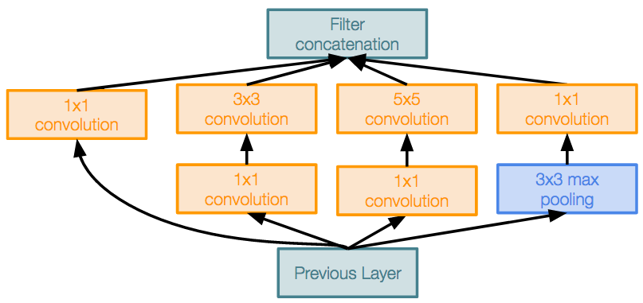
GoogLeNet: Inception模块
Inception 模块
带并行分支的局部单元
整个网络中局部结构重复多次
Szegedy et al, “Going deeper with convolutions”, CVPR 2015

Slide 36
GoogLeNet: Inception模块
Inception 模块
带并行分支的局部单元
整个网络中局部结构重复多次
使用 1x1 “Bottleneck” 层减少输入conv之前通道数
涉及到分离滤波器
Perona, “Deformable kernels for early vision”. PAMI 1995
Szegedy et al, “Going deeper with convolutions”, CVPR 2015

Slide 37
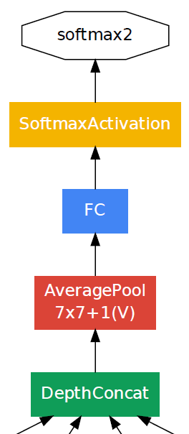
GoogLeNet: 全局平均池化
末端没有全连接层! 使用global average pooling 坍塌空间尺寸, 最后有一个线性层计算输出类别响应
(回想VGG-16: 大部分参数在FC层!)
 | Input size |  | Layer |  |  |  | Output size
Layer | C | H/W | filters | kernel | stride | pad | C | H/W | memory (KB) | params (k) | flop (M)
avg-pool | 1024 | 7 |  | 7 | 1 | 0 | 1024 | 1 | 4 | 0 | 0
fc | 1024 |  | 1000 |  |  |  | 1000 |  | 0 | 1025 | 1
Layer | C | H/W | filters | kernel | stride | pad | C | H/W | memory (KB) | params (K) | flop (M)
flatten | 512 | 7 |  |  |  |  | 25088 |  | 98
fc6 | 25088 |  |  | 4096 |  |  | 4096 |  | 16 | 102760 | 103
fc7 | 4096 |  |  | 4096 |  |  | 4096 |  | 16 | 16777 | 17
fc8 | 4096 |  |  | 1000 |  |  | 1000 |  | 4 | 4096 | 4
Compare with VGG-16:

Slide 38
GoogLeNet:全局平均池化
末端没有全连接层! 使用global average pooling 坍塌空间尺寸, 最后有一个线性层计算输出类别响应
(回想VGG-16: 大部分参数在FC层!)
 | Input size |  | Layer |  |  |  | Output size
Layer | C | H/W | filters | kernel | stride | pad | C | H/W | memory (KB) | params (k) | flop (M)
avg-pool | 1024 | 7 |  | 7 | 1 | 0 | 1024 | 1 | 4 | 0 | 0
fc | 1024 |  | 1000 |  |  |  | 1000 |  | 0 | 1025 | 1
Layer | C | H/W | filters | kernel | stride | pad | C | H/W | memory (KB) | params (K) | flop (M)
flatten | 512 | 7 |  |  |  |  | 25088 |  | 98
fc6 | 25088 |  |  | 4096 |  |  | 4096 |  | 16 | 102760 | 103
fc7 | 4096 |  |  | 4096 |  |  | 4096 |  | 16 | 16777 | 17
fc8 | 4096 |  |  | 1000 |  |  | 1000 |  | 4 | 4096 | 4
Compare with VGG-16:

Slide 39
GoogLeNet: 辅助分类器
在末端使用损失函数进行训练性能不佳:
网络太深, 梯度传播失效
因此, 增加 “辅助分类层” 在网络的中间点
GoogLeNet 是在batch normalization（批归一化）出现之前的网络! 有了BatchNorm 之后不需要在使用辅助分类层了

Slide 40
本章内容
9.1.ImageNet分类挑战
9.2.AlexNet
9.3.VGG
9.4.GoogleNet
9.5.Residual Network
9.6.不同网络比较及改进

Slide 41
ImageNet分类挑战
Lin et al
Sanchez & Perronnin
Krizhevsky et al (AlexNet)
Zeiler & Fergus
Simonyan & Zisserman (VGG)
Szegedy et al (GoogLeNet)
He et al (ResNet)
Shao et al
Hu et al
(SENet)
Russakovsky et al

Slide 42
ImageNet分类挑战
Lin et al
Sanchez & Perronnin
Krizhevsky et al (AlexNet)
Zeiler & Fergus
Simonyan & Zisserman (VGG)
Szegedy et al (GoogLeNet)
He et al (ResNet)
Shao et al
Hu et al
(SENet)
Russakovsky et al

Slide 43
残差网络
一旦我们有了Batch Normalization（批归一化）, 我们能训练10+层的网络. 网络层数更深会发生什么?
He et al, “Deep Residual Learning for Image Recognition”, CVPR 2016

Slide 44
残差网络
一旦我们有了Batch Normalization（批归一化）, 我们能训练10+层的网络. 网络层数更深会发生什么?
深层模型性能不如浅层模型!
最初猜测:由于模型规模变大，深度模型会导致过拟合
测试错误
56-layer
20-layer
迭代数
He et al, “Deep Residual Learning for Image Recognition”, CVPR 2016

Slide 45
残差网络
一旦我们有了Batch Normalization, 我们能训练10+层的网络. 网络层数更深会发生什么?
训练错误
测试错误
56-layer
56-layer
20-layer
20-layer
迭代数
迭代数
实际上深度模型是欠拟合的因为不管怎样其性能都不如浅层模型
He et al, “Deep Residual Learning for Image Recognition”, CVPR 2016

Slide 46
残差网络
深层模型能模拟浅层模型: 直接复制浅层模型, 将额外增加的层设置为恒等映射
因此深层模型性能至少好于浅层模型
假设: 这是一个优化问题。深层模型是难于优化的，实际中无法学习到恒等映射模拟浅层模型。
He et al, “Deep Residual Learning for Image Recognition”, CVPR 2016

Slide 47
残差网络
深层模型能模拟浅层模型: 直接复制浅层模型, 将额外增加的层设置为恒等映射
因此深层模型性能至少好于浅层模型
假设: 这是一个优化问题。深层模型是难于优化的，实际中无法学习到恒等映射模拟浅层模型。
方案: 改变网络来使得额外的层学习恒等函数变得容易!
He et al, “Deep Residual Learning for Image Recognition”, CVPR 2016

Slide 48
残差网络
方案: 改变网络来使得额外的层学习恒等函数变得容易!
H(x)
relu
F(x) + x
conv
conv
F(x)
加性 “短路”
relu
relu
conv
conv
X
X
“Plain” 块
残差块
He et al, “Deep Residual Learning for Image Recognition”, CVPR 2016

Slide 49
残差网络
方案: 改变网络来使得额外的层学习恒等函数变得容易!
H(x)
relu
F(x) + x
conv
如果设置为0, 整个块将学习恒等映射!
conv
F(x)
加性 “短路”
relu
relu
conv
conv
X
X
“Plain” 块
残差块
He et al, “Deep Residual Learning for Image Recognition”, CVPR 2016

Slide 50
残差网络
Softmax
FC 1000
Pool
3x3 conv, 512
3x3 conv, 512
残差网络由若干残差块堆叠而成
常规设计, 类似 VGG: 每一个残差块有 两个3x3 conv块
网络被分为多个阶段: 每一阶段第一个块通过设置步长为2来降低两倍分辨率并加倍输出通道数
3x3 conv, 512
relu
3x3 conv, 512
F(x) + x
3x3 conv, 512
3x3 conv, 512, /2
...
3x3 conv
3x3 conv, 128
F(x)
3x3 conv, 128
relu
3x3 conv, 128
3x3 conv, 128
3x3 conv
3x3 conv, 128
3x3 conv, 128, / 2
3x3 conv, 64
3x3 conv, 64
X
3x3 conv, 64
Residual block
3x3 conv, 64
3x3 conv, 64
3x3 conv, 64
Pool
7x7 conv, 64, / 2
He et al, “Deep Residual Learning for Image Recognition”, CVPR 2016
Input

Slide 51
残差网络
Softmax
FC 1000
Pool
3x3 conv, 512
3x3 conv, 512
3x3 conv, 512
使用和GoogleNet一样的主干网络，在残差块之前将输入下采样4倍
3x3 conv, 512
3x3 conv, 512
3x3 conv, 512, /2
...
3x3 conv, 128
 | Input size |  | Layer |  |  |  | Output size
Layer | C | H/W | filters | kernel | stride | pad | C | H/W | memory (KB) | params (k) | flop (M)
conv | 3 | 224 | 64 | 7 | 2 | 3 | 64 | 112 | 3136 | 9 | 118
max-pool | 64 | 112 |  | 3 | 2 | 1 | 64 | 56 | 784 | 0 | 2
3x3 conv, 128
3x3 conv, 128
3x3 conv, 128
3x3 conv, 128
3x3 conv, 128, / 2
3x3 conv, 64
3x3 conv, 64
3x3 conv, 64
3x3 conv, 64
3x3 conv, 64
3x3 conv, 64
Pool
7x7 conv, 64, / 2
He et al, “Deep Residual Learning for Image Recognition”, CVPR 2016
Input

Slide 52
残差网络
Softmax
FC 1000
Pool
3x3 conv, 512
3x3 conv, 512
3x3 conv, 512
3x3 conv, 512
3x3 conv, 512
3x3 conv, 512, /2
类似 GoogLeNet, 没用大的fully-connected-layers: 使用 global average pooling （全局平均池化）和一个线性层作为输出层替代
...
3x3 conv, 128
3x3 conv, 128
3x3 conv, 128
3x3 conv, 128
3x3 conv, 128
3x3 conv, 128, / 2
3x3 conv, 64
3x3 conv, 64
3x3 conv, 64
3x3 conv, 64
3x3 conv, 64
3x3 conv, 64
Pool
7x7 conv, 64, / 2
He et al, “Deep Residual Learning for Image Recognition”, CVPR 2016
Input

Slide 53
残差网络
Softmax
FC 1000
Pool
ResNet-18:
Stem: 1 conv layer
Stage 1 (C=64): 2 res. block = 4 conv
Stage 2 (C=128): 2 res. block = 4 conv
Stage 3 (C=256): 2 res. block = 4 conv
Stage 4 (C=512): 2 res. block = 4 conv
Linear
ImageNet top-5 错误率: 10.92
GFLOP: 1.8
3x3 conv, 512
3x3 conv, 512
3x3 conv, 512
3x3 conv, 512
3x3 conv, 512
3x3 conv, 512, /2
...
3x3 conv, 128
3x3 conv, 128
3x3 conv, 128
3x3 conv, 128
3x3 conv, 128
3x3 conv, 128, / 2
3x3 conv, 64
3x3 conv, 64
3x3 conv, 64
3x3 conv, 64
3x3 conv, 64
3x3 conv, 64
Pool
He et al, “Deep Residual Learning for Image Recognition”, CVPR 2016
Error rates are 224x224 single-crop testing, reported by torchvision
7x7 conv, 64, / 2
Input

Slide 54
残差网络
Softmax
FC 1000
Pool
ResNet-18:
Stem: 1 conv layer
Stage 1 (C=64): 2 res. block = 4 conv
Stage 2 (C=128): 2 res. block = 4 conv
Stage 3 (C=256): 2 res. block = 4 conv
Stage 4 (C=512): 2 res. block = 4 conv
Linear
ImageNet top-5 错误率: 10.92
GFLOP: 1.8
ResNet-34:
Stem: 1 conv layer
Stage 1: 3 res. block = 6 conv
Stage 2: 4 res. block = 8 conv
Stage 3: 6 res. block = 12 conv
Stage 4: 3 res. block = 6 conv
Linear
ImageNet top-5 错误率: 8.58
GFLOP: 3.6
3x3 conv, 512
3x3 conv, 512
3x3 conv, 512
3x3 conv, 512
3x3 conv, 512
3x3 conv, 512, /2
...
3x3 conv, 128
3x3 conv, 128
3x3 conv, 128
3x3 conv, 128
3x3 conv, 128
3x3 conv, 128, / 2
3x3 conv, 64
3x3 conv, 64
3x3 conv, 64
3x3 conv, 64
3x3 conv, 64
3x3 conv, 64
Pool
He et al, “Deep Residual Learning for Image Recognition”, CVPR 2016
Error rates are 224x224 single-crop testing, reported by torchvision
7x7 conv, 64, / 2
Input

Slide 55
残差网络
Softmax
FC 1000
Pool
ResNet-18:
Stem: 1 conv layer
Stage 1 (C=64): 2 res. block = 4 conv
Stage 2 (C=128): 2 res. block = 4 conv
Stage 3 (C=256): 2 res. block = 4 conv
Stage 4 (C=512): 2 res. block = 4 conv
Linear
ImageNet top-5 错误率: 10.92
GFLOP: 1.8
ResNet-34:
Stem: 1 conv layer
Stage 1: 3 res. block = 6 conv
Stage 2: 4 res. block = 8 conv
Stage 3: 6 res. block = 12 conv
Stage 4: 3 res. block = 6 conv
Linear
ImageNet top-5 错误率: 8.58
GFLOP: 3.6
3x3 conv, 512
3x3 conv, 512
3x3 conv, 512
3x3 conv, 512
3x3 conv, 512
3x3 conv, 512, /2
...
3x3 conv, 128
3x3 conv, 128
3x3 conv, 128
3x3 conv, 128
3x3 conv, 128
3x3 conv, 128, / 2
3x3 conv, 64
3x3 conv, 64
3x3 conv, 64
3x3 conv, 64
VGG-16:
ImageNet top-5 错误率: 9.62
GFLOP: 13.6
3x3 conv, 64
3x3 conv, 64
Pool
He et al, “Deep Residual Learning for Image Recognition”, CVPR 2016
Error rates are 224x224 single-crop testing, reported by torchvision
7x7 conv, 64, / 2
Input

Slide 56
残差网络: 基本块
Conv(3x3, C->C)
Conv(3x3, C->C)
“Basic”
残差块
He et al, “Deep Residual Learning for Image Recognition”, CVPR 2016

Slide 57
残差网络: 基本块
Conv(3x3, C->C)
FLOPs: 9HWC²
Conv(3x3, C->C)
FLOPs: 9HWC²
“Basic”
残差块
总共 FLOPs:
18HWC²
He et al, “Deep Residual Learning for Image Recognition”, CVPR 2016

Slide 58
残差网络: Bottleneck 块
Conv(1x1, C->4C)
Conv(3x3, C->C)
FLOPs: 9HWC²
Conv(3x3, C->C)
Conv(3x3, C->C)
FLOPs: 9HWC²
Conv(1x1, 4C->C)
“Basic”
残差块
总共 FLOPs:
18HWC²
“Bottleneck”
残差块
He et al, “Deep Residual Learning for Image Recognition”, CVPR 2016

Slide 59
残差网络: Bottleneck 块
更多层, 更少的计算开销!
FLOPs: 4HWC²
Conv(1x1, C->4C)
Conv(3x3, C->C)
FLOPs: 9HWC²
FLOPs: 9HWC²
Conv(3x3, C->C)
Conv(3x3, C->C)
FLOPs: 9HWC²
FLOPs: 4HWC²
Conv(1x1, 4C->C)
“Basic”
残差块
总共FLOPs:
18HWC²
总共FLOPs:
17HWC²
“Bottleneck”
残差块
He et al, “Deep Residual Learning for Image Recognition”, CVPR 2016

Slide 60
残差网络
Softmax
FC 1000
Pool
3x3 conv, 512
3x3 conv, 512
3x3 conv, 512
3x3 conv, 512
3x3 conv, 512
3x3 conv, 512, /2
 |  |  | Stage 1 |  | Stage 2 |  | Stage 3 |  | Stage 4
 | Block type | Stem layers | Blocks | Layers | Blocks | Layers | Blocks | Layers | Blocks | Layers | FC layers | GFLOP | ImageNet top-5 error
ResNet-18 | Basic | 1 | 2 | 4 | 2 | 4 | 2 | 4 | 2 | 4 | 1 | 1.8 | 10.92
ResNet-34 | Basic | 1 | 3 | 6 | 4 | 8 | 6 | 12 | 3 | 6 | 1 | 3.6 | 8.58
ResNet-50 | Bottle | 1 | 3 | 9 | 4 | 12 | 6 | 18 | 3 | 9 | 1 | 3.8 | 7.13
ResNet-101 | Bottle | 1 | 3 | 9 | 4 | 12 | 23 | 69 | 3 | 9 | 1 | 7.6 | 6.44
ResNet-152 | Bottle | 1 | 3 | 9 | 8 | 24 | 36 | 108 | 3 | 9 | 1 | 11.3 | 5.94
...
3x3 conv, 128
3x3 conv, 128
3x3 conv, 128
3x3 conv, 128
3x3 conv, 128
3x3 conv, 128, / 2
3x3 conv, 64
3x3 conv, 64
3x3 conv, 64
3x3 conv, 64
3x3 conv, 64
3x3 conv, 64
Pool
He et al, “Deep Residual Learning for Image Recognition”, CVPR 2016
Error rates are 224x224 single-crop testing, reported by torchvision
7x7 conv, 64, / 2
Input

Slide 61
残差网络
Softmax
FC 1000
Pool
3x3 conv, 512
3x3 conv, 512
ResNet-50 和ResNet-34一样, 但是将Basic 块替换为Bottleneck 块.
对于许多任务而言，这是一个最好的基线结果!
3x3 conv, 512
3x3 conv, 512
3x3 conv, 512
3x3 conv, 512, /2
 |  |  | Stage 1 |  | Stage 2 |  | Stage 3 |  | Stage 4
 | Block type | Stem layers | Blocks | Layers | Blocks | Layers | Blocks | Layers | Blocks | Layers | FC layers | GFLOP | ImageNet top-5 error
ResNet-18 | Basic | 1 | 2 | 4 | 2 | 4 | 2 | 4 | 2 | 4 | 1 | 1.8 | 10.92
ResNet-34 | Basic | 1 | 3 | 6 | 4 | 8 | 6 | 12 | 3 | 6 | 1 | 3.6 | 8.58
ResNet-50 | Bottle | 1 | 3 | 9 | 4 | 12 | 6 | 18 | 3 | 9 | 1 | 3.8 | 7.13
ResNet-101 | Bottle | 1 | 3 | 9 | 4 | 12 | 23 | 69 | 3 | 9 | 1 | 7.6 | 6.44
ResNet-152 | Bottle | 1 | 3 | 9 | 8 | 24 | 36 | 108 | 3 | 9 | 1 | 11.3 | 5.94
...
3x3 conv, 128
3x3 conv, 128
3x3 conv, 128
3x3 conv, 128
3x3 conv, 128
3x3 conv, 128, / 2
3x3 conv, 64
3x3 conv, 64
3x3 conv, 64
3x3 conv, 64
3x3 conv, 64
3x3 conv, 64
Pool
He et al, “Deep Residual Learning for Image Recognition”, CVPR 2016
Error rates are 224x224 single-crop testing, reported by torchvision
7x7 conv, 64, / 2
Input

Slide 62
残差网络
Softmax
FC 1000
Pool
3x3 conv, 512
3x3 conv, 512
更深的 ResNet-101 和 ResNet-152 模型更精确, 但是计算量也相应增加
3x3 conv, 512
3x3 conv, 512
3x3 conv, 512
3x3 conv, 512, /2
 |  |  | Stage 1 |  | Stage 2 |  | Stage 3 |  | Stage 4
 | Block type | Stem layers | Blocks | Layers | Blocks | Layers | Blocks | Layers | Blocks | Layers | FC layers | GFLOP | ImageNet top-5 error
ResNet-18 | Basic | 1 | 2 | 4 | 2 | 4 | 2 | 4 | 2 | 4 | 1 | 1.8 | 10.92
ResNet-34 | Basic | 1 | 3 | 6 | 4 | 8 | 6 | 12 | 3 | 6 | 1 | 3.6 | 8.58
ResNet-50 | Bottle | 1 | 3 | 9 | 4 | 12 | 6 | 18 | 3 | 9 | 1 | 3.8 | 7.13
ResNet-101 | Bottle | 1 | 3 | 9 | 4 | 12 | 23 | 69 | 3 | 9 | 1 | 7.6 | 6.44
ResNet-152 | Bottle | 1 | 3 | 9 | 8 | 24 | 36 | 108 | 3 | 9 | 1 | 11.3 | 5.94
...
3x3 conv, 128
3x3 conv, 128
3x3 conv, 128
3x3 conv, 128
3x3 conv, 128
3x3 conv, 128, / 2
3x3 conv, 64
3x3 conv, 64
3x3 conv, 64
3x3 conv, 64
3x3 conv, 64
3x3 conv, 64
Pool
He et al, “Deep Residual Learning for Image Recognition”, CVPR 2016
Error rates are 224x224 single-crop testing, reported by torchvision
7x7 conv, 64, / 2
Input

Slide 63
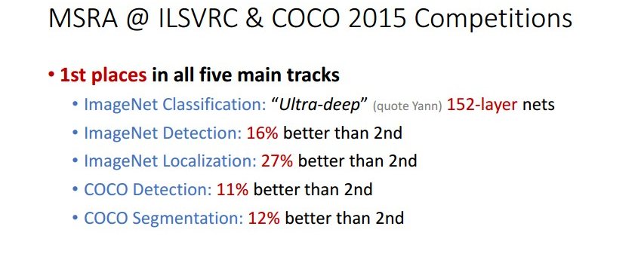
残差网络
能够训练非常深的网络
网络变深性能能够变好
在所有ILSVRC 和COCO 2015 竞赛横扫第一
今天仍然广泛应用!
He et al, “Deep Residual Learning for Image Recognition”, CVPR 2016

Slide 64
改进残差网络: 块设计
原始残差块
“预激活” ResNet块
ReLU
注意 ReLU 在残差之后:
实际不能实现恒等映射的学习，因为输出非负!
Conv
Batch Norm
ReLU
Conv
Batch Norm
ReLU
注意ReLU 在残差里面:
能够学习恒等函数通过设置Conv权重为0!
Conv
Batch Norm
ReLU
Conv
Batch Norm
He et al, ”Identity mappings in deep residual networks”, ECCV 2016

Slide 65
改进残差网络: 块设计
原始ResNet 块
“预激活” ResNet块
ReLU
能微弱提升性能
(ImageNet top-1 错误率)
ResNet-152: 21.3 vs 21.1
ResNet-200: 21.8 vs 20.7
实际中很少使用
Conv
Batch Norm
ReLU
Conv
Batch Norm
ReLU
Conv
Batch Norm
ReLU
Conv
Batch Norm
He et al, ”Identity mappings in deep residual networks”, ECCV 2016

Slide 66
本章内容
9.1.ImageNet分类挑战
9.2.AlexNet
9.3.VGG
9.4.GoogleNet
9.5.Residual Network
9.6.不同网络比较及改进

Slide 67
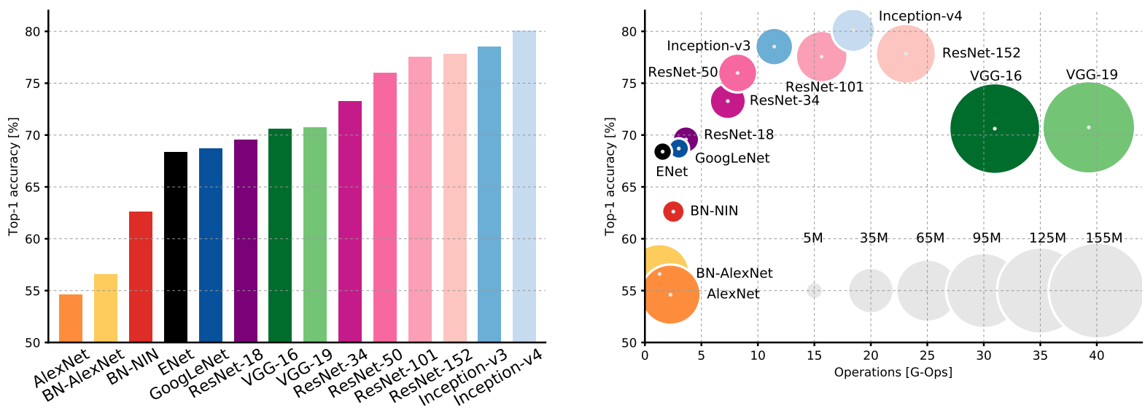
复杂度比较
BN: 批归一化版本
Canziani et al, “An analysis of deep neural network models for practical applications”, 2017

Slide 68
复杂度比较
Inception-v4: Resnet + Inception!
BN:批归一化版本
Canziani et al, “An analysis of deep neural network models for practical applications”, 2017

Slide 69
复杂度比较
VGG: 高存储, 最多的计算
BN:批归一化版本
Canziani et al, “An analysis of deep neural network models for practical applications”, 2017

Slide 70
复杂度比较
GoogLeNet: 非常高效!
BN:批归一化版本
Canziani et al, “An analysis of deep neural network models for practical applications”, 2017

Slide 71
复杂度比较
AlexNet: 低计算, 参数规模大
BN:批归一化版本
Canziani et al, “An analysis of deep neural network models for practical applications”, 2017

Slide 72
复杂度比较
ResNet: 设计简单, 中等效率, 高精确度
BN:批归一化版本
Canziani et al, “An analysis of deep neural network models for practical applications”, 2017

Slide 73
ImageNet 分类挑战
Lin et al
Sanchez & Perronnin
Krizhevsky et al (AlexNet)
Zeiler & Fergus
Simonyan & Zisserman (VGG)
Szegedy et al (GoogLeNet)
He et al (ResNet)
Shao et al
Hu et al
(SENet)
Russakovsky et al

Slide 74
ImageNet 分类挑战
Lin et al
Sanchez & Perronnin
Krizhevsky et al (AlexNet)
Zeiler & Fergus
Simonyan & Zisserman (VGG)
Szegedy et al (GoogLeNet)
He et al (ResNet)
Shao et al
Hu et al
(SENet)
Russakovsky et al

Slide 75
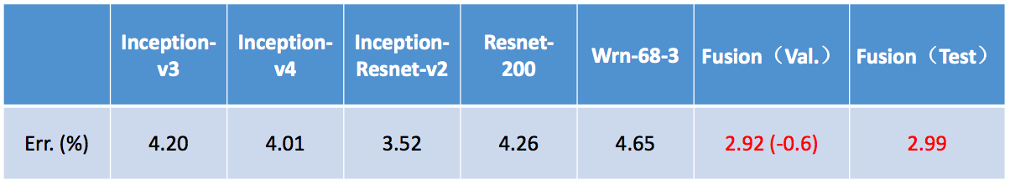
ImageNet 2016 获胜者: 模型集成
多尺度集成Inception, Inception-Resnet, Resnet, Wide Resnet 模块
Shao et al, 2016

Slide 76
改进 ResNets
Conv(1x1, C->4C)
FLOPs:
4HWC²
Conv(3x3, C->C)
FLOPs:
9HWC²
Conv(1x1, 4C->C)
FLOPs:
4HWC²
“Bottleneck”
残差块
总 FLOPs:
17HWC²

Slide 77
改进 ResNets: ResNeXt
G parallel pathways
Conv(1x1, C->4C)
FLOPs:
4HWC²
Conv(1x1, c->4C)
Conv(1x1, c->4C)
Conv(3x3, C->C)
FLOPs:
9HWC²
Conv(3x3, c->c)
…
Conv(3x3, c->c)
Conv(1x1, 4C->C)
FLOPs:
4HWC²
Conv(1x1, 4C->c)
Conv(1x1, 4C->c)
“Bottleneck”
Residual block
总 FLOPs:
17HWC²
Xie et al, “Aggregated residual transformations for deep neural networks”, CVPR 2017

Slide 78
改进ResNets: ResNeXt
G parallel pathways
Conv(1x1, C->4C)
FLOPs:
4HWC²
Conv(1x1, c->4C)
Conv(1x1, c->4C)
4HWCc
Conv(3x3, C->C)
FLOPs:
9HWC²
Conv(3x3, c->c)
…
Conv(3x3, c->c)
9HWc²
Conv(1x1, 4C->C)
FLOPs:
4HWC²
4HWCc
Conv(1x1, 4C->c)
Conv(1x1, 4C->c)
“Bottleneck”
残差块
总 FLOPs:
17HWC²
总 FLOPs:
(8Cc + 9c²)*HWG
Xie et al, “Aggregated residual transformations for deep neural networks”, CVPR 2017

Slide 79
改进 ResNets: ResNeXt
G 并行通路
Conv(1x1, C->4C)
FLOPs:
4HWC²
Conv(1x1, c->4C)
Conv(1x1, c->4C)
4HWCc
Conv(3x3, C->C)
FLOPs:
9HWC²
Conv(3x3, c->c)
…
Conv(3x3, c->c)
9HWc²
Conv(1x1, 4C->C)
FLOPs:
4HWC²
4HWCc
Conv(1x1, 4C->c)
Conv(1x1, 4C->c)
“Bottleneck”
残差块
总FLOPs:
17HWC²
总FLOPs:
(8Cc + 9c²)*HWG
消耗相同当
9Gc² + 8GCc – 17C² = 0
Xie et al, “Aggregated residual transformations for deep neural networks”, CVPR 2017
举例: C=64, G=4, c=24; C=64, G=32, c=4

Slide 80
分组卷积
groups=1:
常规卷积
Input: C_{in} x H x W
Weight: C_{out} x C_{in} x K x K
Output: C_{out} x H’ x W’
FLOPs: C_{out}C_{in}K²HW
所有的卷积内核和所有的C_{in}输入通道接触

Slide 81
分组卷积
groups=2:
两条并行的卷积层各处理一半通道
groups=1:
常规卷积
Input: C_{in} x H x W
Weight: C_{out} x C_{in} x K x K
Output: C_{out} x H’ x W’
FLOPs: C_{out}C_{in}K²HW
所有的卷积内核和所有的C_{in}输入通道接触
Input: C_{in} x H x W
Split
Group 1:
(C_{in} / 2) x H x W
Group 2:
(C_{in} / 2) x H x W
Conv(K x K, C_{in}/2 -> C_{out}/2)
Conv(K x K, C_{in}/2 -> C_{out}/2)
Out 1:
(C_{out} / 2) x H’ x W’
Out 2:
(C_{out} / 2) x H’ x W’
Concat
Output: C_{out} x H’ x W’

Slide 82
分组卷积
groups=1:
常规卷积
Input: C_{in} x H x W
Weight: C_{out} x C_{in} x K x K
Output: C_{out} x H’ x W’
FLOPs: C_{out}C_{in}K²HW
所有的卷积内核和所有的C_{in}输入通道接触
groups=G:
G 并行 conv 层; 每个 “看见” C_{in}/G 输入通道并产生C_{out}/G 输出通道
Input: C_{in} x H x W
Split to G x [(C_{in} / G) x H x W]
Weight: G x (C_{out} / G) x (C_{in} x G) x K x K
G parallel convolutions
Output: G x [(C_{out} / G) x H’ x W’]
Concat to C_{out} x H’ x W’
FLOPs: C_{out}C_{in}K²HW/G

Slide 83
分组卷积
groups=1:
常规卷积
Input: C_{in} x H x W
Weight: C_{out} x C_{in} x K x K
Output: C_{out} x H’ x W’
FLOPs: C_{out}C_{in}K²HW
所有的卷积内核和所有的C_{in}输入通道接触
groups=G:
G 并行 conv 层; 每个 “看见” C_{in}/G 输入通道并产生C_{out}/G 输出通道
Input: C_{in} x H x W
Split to G x [(C_{in} / G) x H x W]
Weight: G x (C_{out} / G) x (C_{in} x G) x K x K
G parallel convolutions
Output: G x [(C_{out} / G) x H’ x W’]
Concat to C_{out} x H’ x W’
FLOPs: C_{out}C_{in}K²HW/G
Depthwise 卷积
特例: G=C_{in}, C_{out} = nC_{in}
每个输入通道与K x K滤波核卷积输出n通道

Slide 84
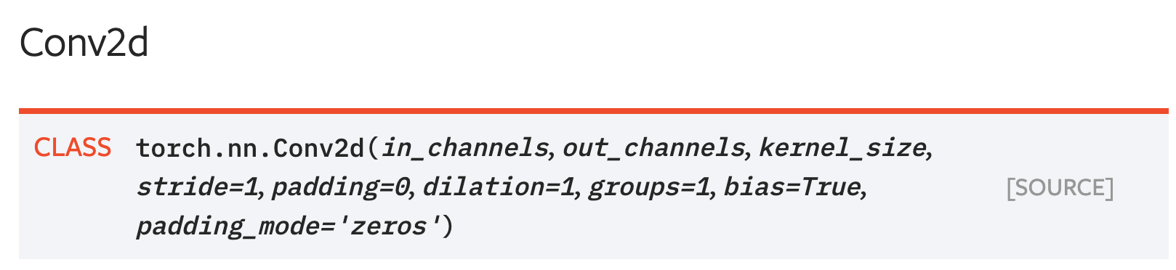
Grouped Convolution in PyTorch
PyTorch convolution gives an option for groups!

Slide 85
改进 ResNets: ResNeXt
G 并行通路
使用分组卷积等价计算
Conv(1x1, Gc->4C)
Conv(1x1, c->4C)
Conv(1x1, c->4C)
4HWCc
Conv(3x3, Gc->Gc, groups=G)
Conv(3x3, c->c)
…
Conv(3x3, c->c)
9HWc²
Conv(1x1, 4C->Gc)
4HWCc
Conv(1x1, 4C->c)
Conv(1x1, 4C->c)
总 FLOPs:
(8Cc + 9c²)*HWG
ResNeXt block:
分组卷积
消耗一样当
9Gc² + 8GCc – 17C² = 0
Xie et al, “Aggregated residual transformations for deep neural networks”, CVPR 2017
举例: C=64, G=4, c=24; C=64, G=32, c=4

Slide 86
ResNeXt: 通过增加分组数来维持计算量!
Model | Groups | Group width | Top-1 Error
ResNet-50 | 1 | 64 | 23.9
ResNeXt-50 | 2 | 40 | 23
ResNeXt-50 | 4 | 24 | 22.6
ResNeXt-50 | 8 | 14 | 22.3
ResNeXt-50 | 32 | 4 | 22.2
Model | Groups | Group width | Top-1 Error
ResNet-101 | 1 | 64 | 22.0
ResNeXt-101 | 2 | 40 | 21.7
ResNeXt-101 | 4 | 24 | 21.4
ResNeXt-101 | 8 | 14 | 21.3
ResNeXt-101 | 32 | 4 | 21.2
增加分组数改进性能保持相同的计算量!
Xie et al, “Aggregated residual transformations for deep neural networks”, CVPR 2017

Slide 87
MobileNets: 微型网络(用于移动设备)
标准卷积块
总开销: 9C²HW
Depthwise 分离卷积
总开销: (9C + C²)HW
ReLU
ReLU
Batch Norm
Batch Norm
C²HW
Conv(1x1, C->C)
“Pointwise Convolution”
Conv(3x3, C->C)
9C²HW
ReLU
Batch Norm
Speedup = 9C²/(9C+C²)
= 9C/(9+C)
=> 9 (as C->inf)
9CHW
Conv(3x3, C->C,
groups=C)
“Depthwise Convolution”
Howard et al, “MobileNets: Efficient Convolutional Neural Networks for Mobile Vision Applications”, 2017

Slide 88
MobileNets:微型网络(用于移动设备)
Depthwise 分离卷积
总开销: (9C + C²)HW
同样相关:
ShuffleNet: Zhang et al, CVPR 2018
MobileNetV2: Sandler et al, CVPR 2018
ShuffleNetV2: Ma et al, ECCV 2018
ReLU
Batch Norm
C²HW
Conv(1x1, C->C)
“Pointwise Convolution”
ReLU
Batch Norm
9CHW
Conv(3x3, C->C,
groups=C)
“Depthwise Convolution”
Howard et al, “MobileNets: Efficient Convolutional Neural Networks for Mobile Vision Applications”, 2017

Slide 89
本章小结
Alexnet
VGG
GoogleNet
残差网络
网络比较

Slide 90
结束

Slide 91
下一次课
目标检测

